Slide 1
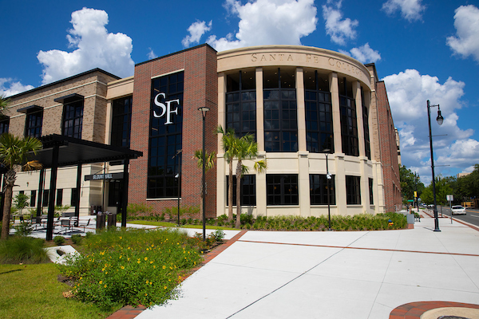
Securing Santa Fe College: $4.5M ITS Cybersecurity Investment
Building a Complete Cybersecurity Program for Santa Fe College
By David Holbrook
Notes:
Good morning. My name is David Holbrook.
I am Asking for $4.5 M over 3 years to improve security posture. turn phishing wins into a real program. — and stop paying to hurt students and stay vulnerable.

Slide 2

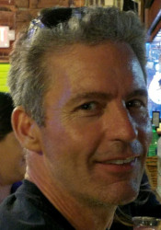
My Credentials & Experience
MRI Systems Engineer
Component-level repair, superconducting magnet ramp/shim, RF-shield design & troubleshooting
IT & Cloud, Debian Linux servers | AWS Solutions Architect – Associate | NGINX, DICOM, APIs & web services
Modern Stack, Docker · Kubernetes · Terraform · Traefik
Cybersecurity
Mitigated live SMTP injection attack, Python & Bash scripting,
Raspberry Pi LTE router + remote diagnostic platform
Current Role: Santa Fe College Cybersecurity Student
Phishing campaign collaborator
Notes:
Years keeping million-dollar systems running under extreme conditions. Same rigor in cyber. I have already stopped real cyber attacks

Slide 3
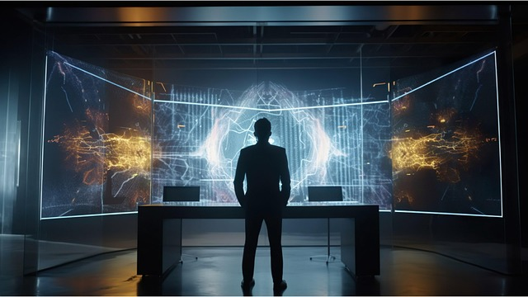

The Threat Landscape – Why we are vulnerable
2024 U.S. losses = $16 billion (FBI IC3)
Phishing = #1 crime
Average education breach ≈ $4–6 million
NetLab + Cisco labs: $200 k/yr → unpatched 2012 R2, crashes, 1-hour reservations, incompletes, wrong grading for modern systemd, gross ADA violations (tiny nested windows)
Notes:
We pay $200 k a year for labs that are a live vulnerability, educationally broken, outdated, and illegally inaccessible. That last bullet is a lawsuit waiting to happen.

Slide 4
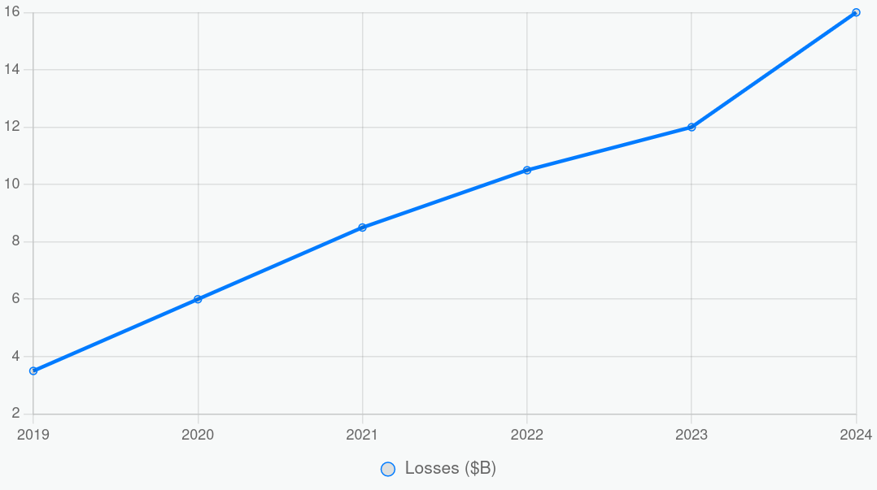
Why Invest Now? Cyber Crime Stats
2024 losses = $16 billion (up from $3.5 B in 2019)
Phishing = #1 reported crime every year
Average education breach cost ≈ $4–6 million
One successful attack could wipe out years of budget.
Notes:
Cyber crime continues to rise

Slide 5
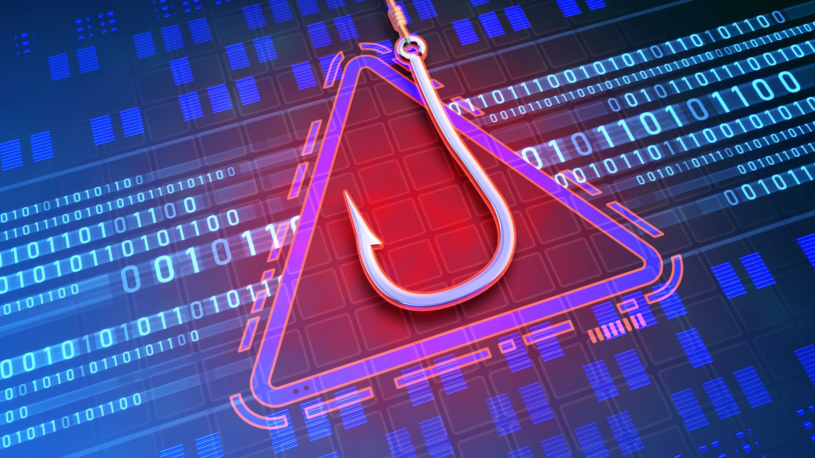
Our Phishing Campaign: What We Did
CIS2352 + ITS Collaboration (2025)
  Collaborated: CIS2352 Ethical Hacking class + ITS using KnowBe4 platform.
  3 simulated emails targeting Facilities, Admin and Educators (~`150 users).
  Goals: Test awareness, promote on best practices, comply with FL & SF college Cybersecurity Standards.
Notes:
Three real, ITS-approved campaigns. Results next.

Slide 6
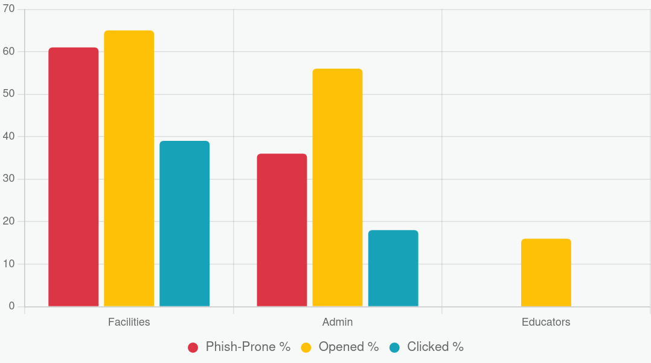
Campaign Outcomes:
Educators 0% Phish-Prone
Facilities (Campaign 1): 61% phish-prone; 65% opened, 39% clicked, 0% reported
Administrators (Campaign 2): 36% phish-prone; 56% opened, 18% clicked, 0% reported
Educators (Campaign 3): 0% phish-prone; 16% opened, 0% clicked, 0% reported
Zero reports across all = need for Hub
Notes:
Educators crushed it. Zero reports across 123 users → perfect reason for the Hub.

Slide 7
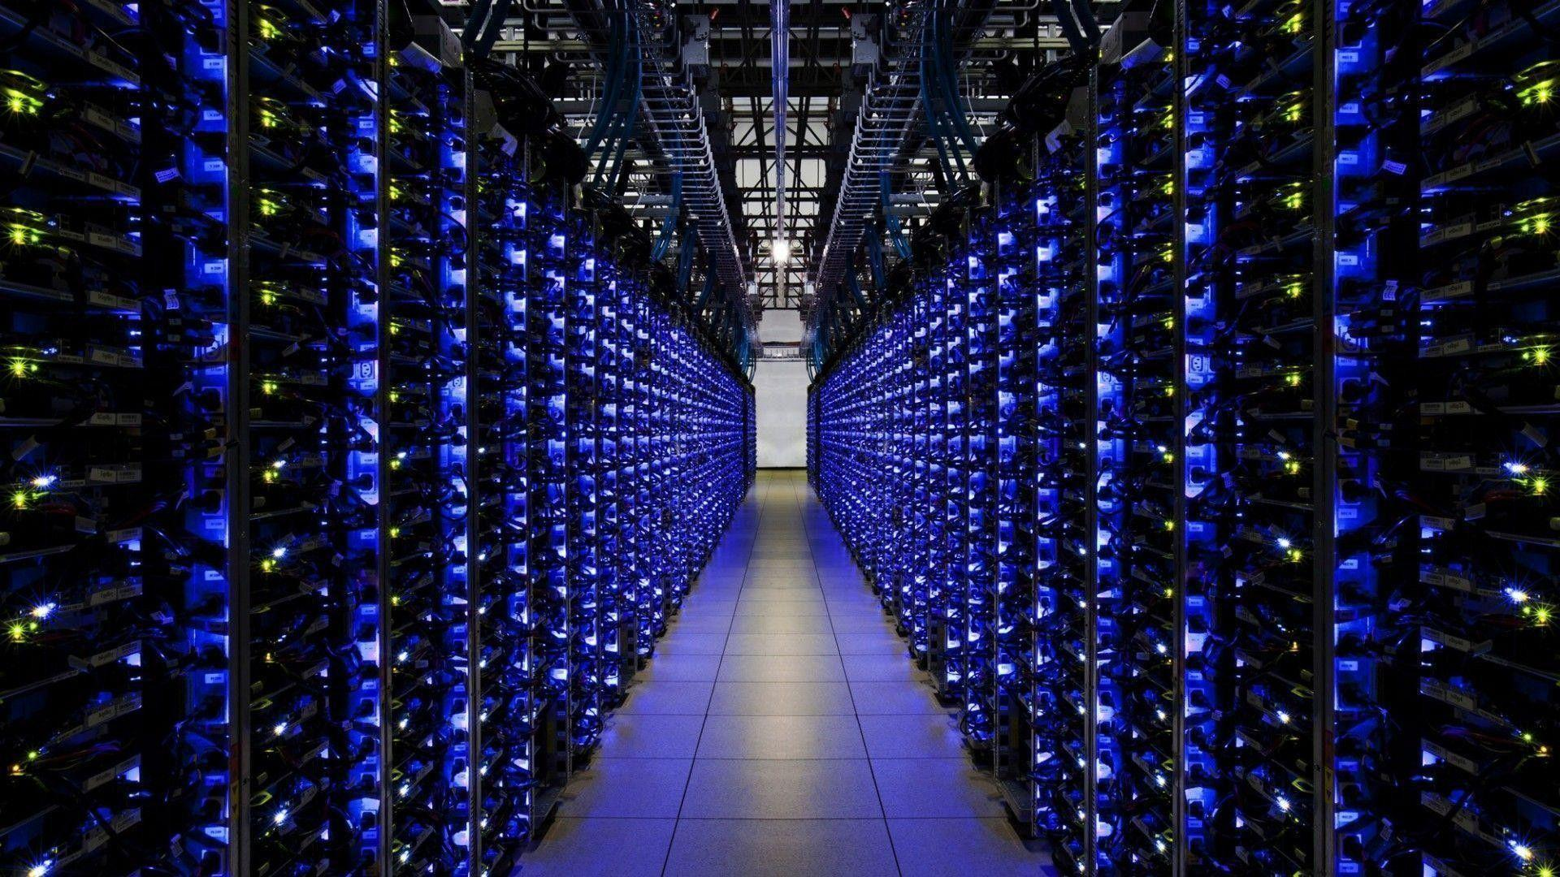
New Capability: Community CyberSecurity Hub
Secure reporting forum (Discourse) – fixes 0 % reporting
Real-time SIEM
(Security Information and Event Management)
Encrypted cloud bucket for evidence & student projects
8 defensive typo domains ($1.3K total)
Notes:
This is the heart of the new program

Slide 8
Keep CIS2352 Involved
Students moderate forum, run simulations, analyze SIEM logs
Proven results (0 % educator phish-prone)
Builds our own talent pipeline
Direct user feedback
Introduction of fresh ideas and assessments.
Notes:
Keep the class in the game

Slide 9
$4.5 Million Request – What It Buys
Proven phishing reduction
Real-time visibility + endpoint protection
Community reporting + modern labs
Dedicated staff + student talent
Item | Description | 3-Year Cost
KnowBe4 Renewal | Phishing platform & training | $50,000
CIS2352 Stipends | Student & faculty collaboration | $75,000
Community Cybersecurity Hub | SIEM + Forum + Cloud storage + typo domains | $800,000
Endpoint Detection & Response | College-wide EDR (CrowdStrike or SentinelOne) | $1,200,000
Training & External Exercises | Advanced modules + pen-tests | $375,000
Staff & 3-Year Runway | 2 Analysts + 1 Engineer + buffer | $2,000,000
TOTAL |  | $4,500,000
Notes:
Complete state of the art modern program

Slide 10
We can do It for Half the price
Replace commercial SIEM/EDR → Wazuh + Elastic (open-source, used by NASA/DoD)
Replace NetLab >> docker (labtainers/GNS3) >> $450-500K saved
Total Savings 2.1 Million
Notes:
If budget is tight, we go open-source and still deliver everything — plus finally fix the labs that are hurting students.

Slide 11
Questions?
David Holbrook
https://mriservice.com
mriservice@gmail.com
https://github.com/MRIservice
Thank You for your time!
Notes:
Happy to dive into security, savings, labs, or next steps.

Slide 12
Bonus: What Happens Without Funding
Status Quo = High Risk.
No System Information and Event Management SIEM →blind to attacks in progress
No dedicated staff → hope someone notices at 2 a.m.
Lost student talent pipeline

Slide 13
References
FBI Internet Crime Report 2024
https://www.ic3.gov/Media/PDF/AnnualReport/2024_IC3Report.pdf
KnowBe4 Phish-Prone Percentage Benchmark Report 2025
https://www.knowbe4.com/phish-prone-benchmark
NDG NETLAB+ Campus License Pricing 2024–2025 (public tier)
https://www.netdevgroup.com/pricing
U.S. Cyber Crime Losses 2019–2024 (FBI IC3 historical data)
https://www.ic3.gov/Media/PDF/AnnualReport/
Wazuh Open-Source SIEM & EDR
https://wazuh.com
Labtainers – Docker Cybersecurity Labs (U.S. Naval Postgraduate School)
https://nps.edu/web/c3o/labtainers
GNS3 Network Emulator
https://www.gns3.com
Discourse Open-Source Forum
https://discourse.org
ADA Section 508 & WCAG 2.1 Accessibility Guidelines
https://www.ada.gov/resources/title-ii-primer/
https://www.w3.org/TR/WCAG21/

